Slide 1
Social and Strengths-Based Approaches to
Mental Health Support
From Global Practice to Local Delivery
@AssocMHP
#CommunityMH

Slide 2
 | Programme | Speakers
1 | Welcome and Introduction @NormanLamb | Sir Norman Lamb, South London and Maudsley NHS Foundation Trust
2 | Introduction to the WHO Guidance and Overview @WHO @MichelleFunk3 | Dr Michelle Funk, World Health Organization
3 | KeyRing Living Support Networks @KeyRingLiving @KarynAtKeyRing | Karyn Kirkpatrick and Luke Entwistle, KeyRing Living Support Networks
4 | Shared Lives Plus @SharedLivesPlus | Jayne Wilson, Emma Jenkins and Sam Temby, Shared Lives Plus
5 | Missing Link @MissingLink_MLH | Sara Gray and Tracey Stinchcombe, Missing Link
6 | Discussion | All
7 | Close @NormanLamb | Sir Norman Lamb, South London and Maudsley NHS Foundation Trust

Slide 3
Welcome and Introduction
Sir Norman lamb
@NormanLamb
@AssocMHP
#CommunityMH

Slide 4
Dr Michelle Funk
World Health Organization
@WHO
@MichelleFunk3
@AssocMHP
#CommunityMH

Slide 5


Slide 6
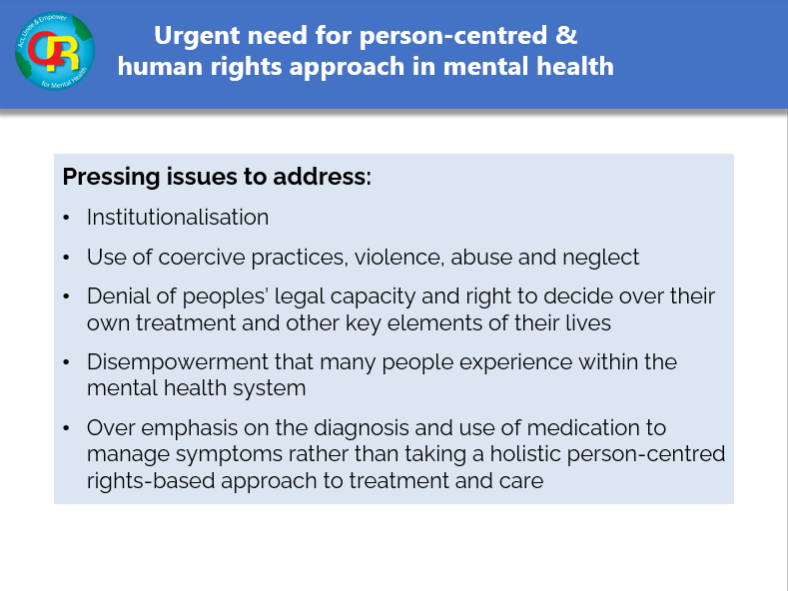
Notes:
6

Slide 7

What needs to change?
radical transformation of mental health system and services
paradigm change away from the biomedical model towards a more holistic model with human rights at its core
Goal:
develop and provide coercion free services that respect peoples’ rights and promote community inclusion
services that are holistic and address all areas of their lives that are important to people; including relationships, education, employment and social protection

Slide 8
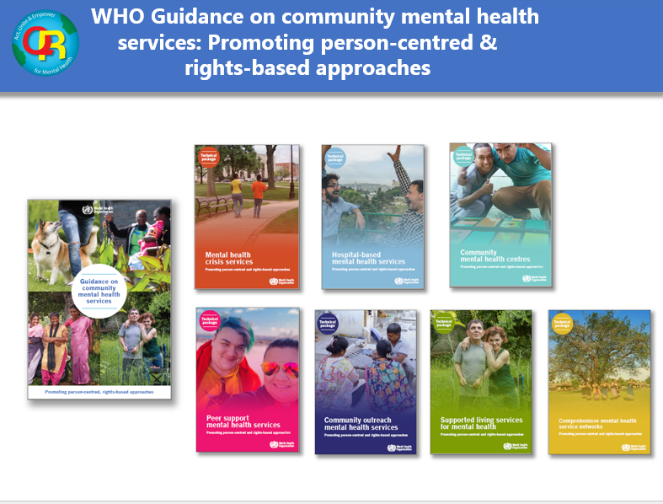
Notes:
8

Slide 9
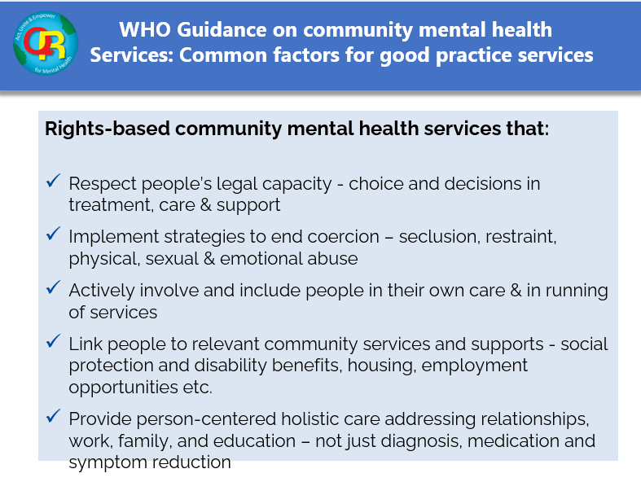
Notes:
9

Slide 10
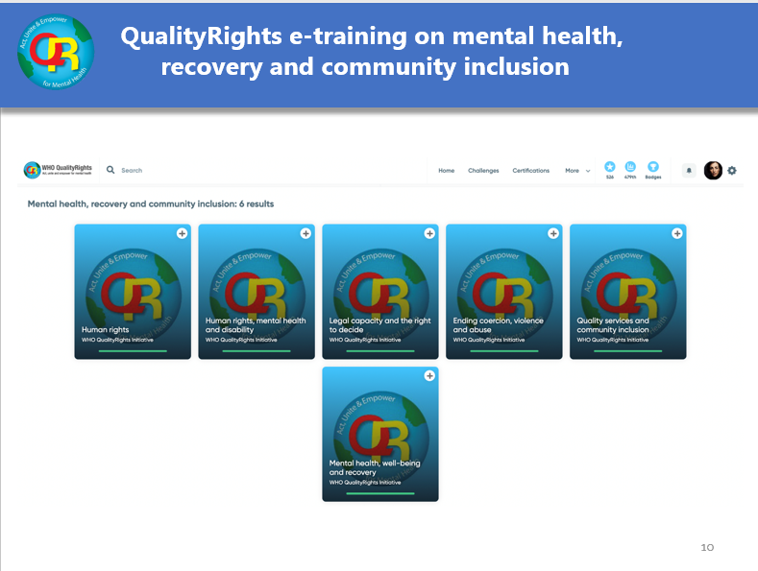

Slide 11
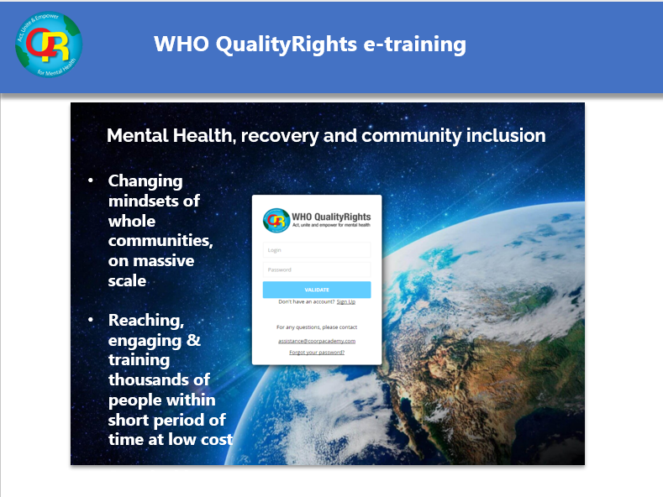
Capacity building on human rights
in mental health
Changing mindsets of whole communities, on massive scale
Reaching, engaging & training thousands of people within short period of time at low cost
Sustainable change

Slide 12
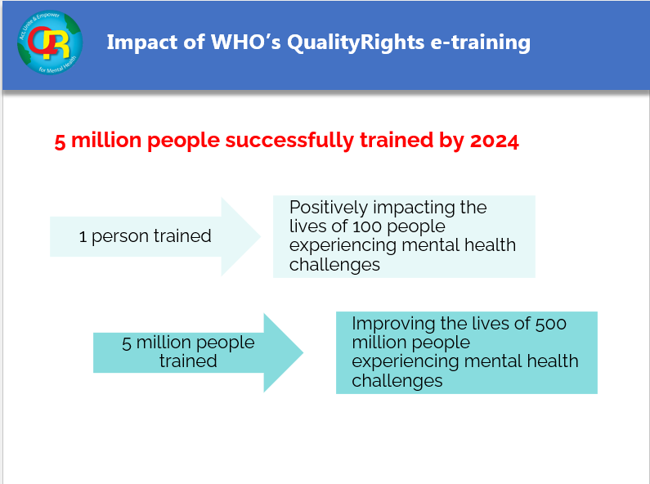

Slide 13
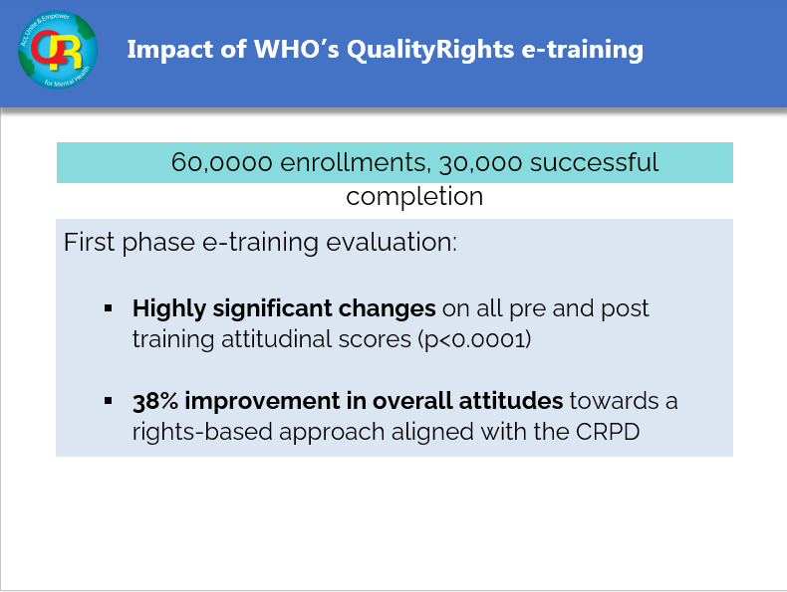
Notes:
13

Slide 14
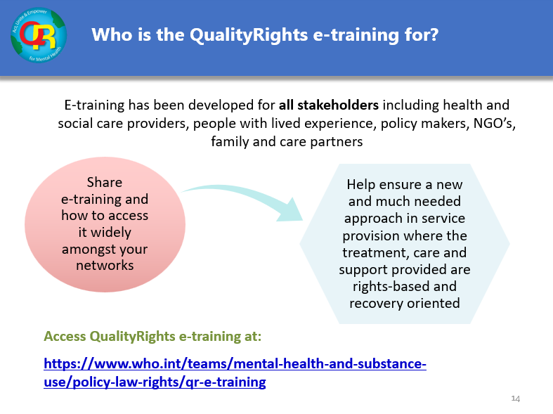

Slide 15
THANK YOU!

Slide 16
Karyn Kirkpatrick and Luke Entwistle
KeyRing Living Support Networks, United Kingdom
@KeyRingLiving
@KarynAtKeyRing
@AssocMHP
#CommunityMH

Slide 17
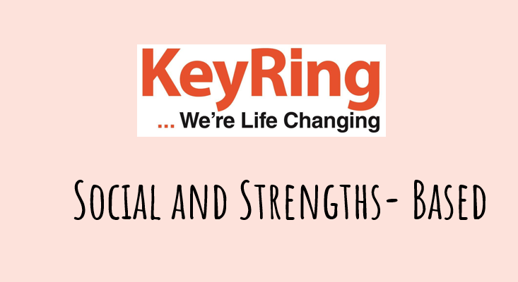

Slide 18
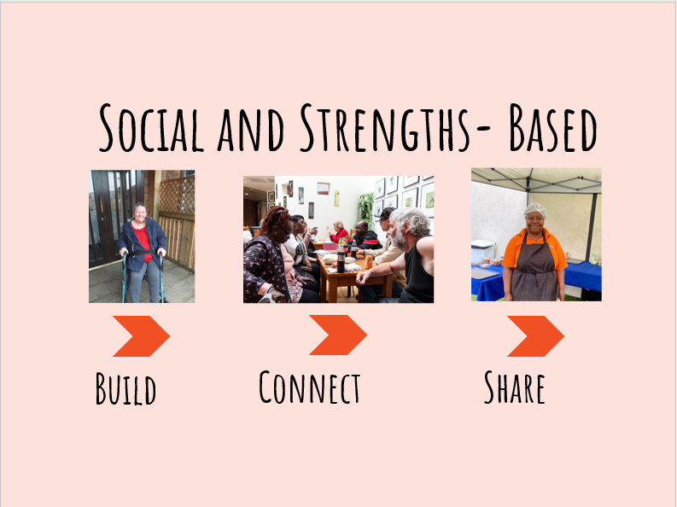
Notes:
What does social and strengths based mean to us?
We build people's skills, we connect them and we encourage them to share.
We also work with a lot of partners to share this way of supporting people. We have already supported the development of KeyRing like approaches to support in places like the Netherlands, Scotland and even as far as Australia and New Zealand.
So when we were approached by the World Health Organisation to be part of their guidance on community mental health services: we knew this was a great opportunity to share what we do and the difference that it makes.
Since then we've spoken to a number of others who are part of the document and it strikes me that the key similarities are the relative simplicity and common sense attitude of the approaches. The organisations we've interacted with start by putting the person at the centre of their support and they all hold a firm belief that people have skills, that people can do things for themselves and that life should not revolve around support. So we are in great company.

Slide 19
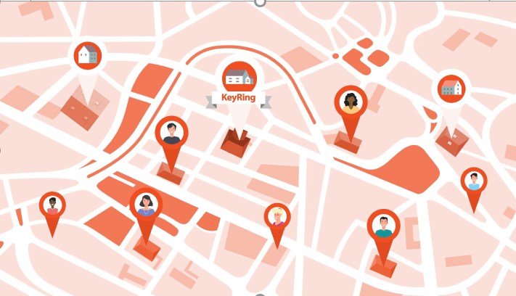
Notes:
So how do we do it?
Our core model is what we call a network of support.
People live in their own place, they may already be living there or we may help them to choose a property in that area. Everyone lives quite close by and are supported to get to know each other. As they get to know each other better they may build friendships and offer each other support. This could be going shopping together or just having someone else to talk to about their successes and concerns. They get to know about things going on in their local community and we actively invite the community in. Our hubs will regularly have neighbours coming along. We look at the resources in the community and don’t reinvent the wheel. For example, we will help people access local leisure facilities etc. The people in the community get to know and involve our Members.
Lives should never rely purely on paid for support. It's not realistic and it is not safe.
The recently released WHO quality rights training, talks about the fact that individuals who are vulnerable to human rights violations are more likely to be stigmatized by society as they are perceived as different. This results in them becoming isolated and lacking social support that we all need in our lives.
On an individual level, we work with people to build their independence. So we will start with what they want to achieve and help them get there. Sometimes people have been told they can’t achieve something and we have to raise their expectations of themselves. So we could be doing things like supporting people to budget, plan, access healthcare settings., get through legal proceedings, stay safe in the community etc etc.
Where people build their skills, connect with others and share what they have to offer as ordinary citizens. I'll let Luke tell you more.

Slide 20
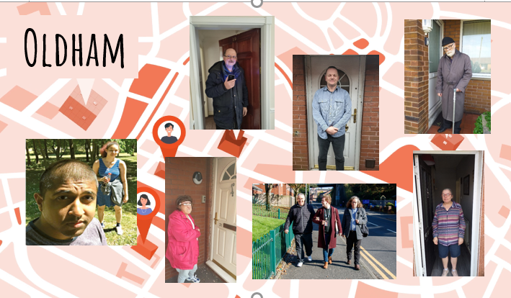
Notes:
I’m a community support worker in Oldham where we support around 160 people to live life to their full potential, these are just a handful of the people we support. The Members we support are all from different backgrounds and they all have their skills and abilities to share and celebrate. And because everyone is unique they all have support that is built around them their aims, ambitions and needs.
Let me introduce you to one.

Slide 21
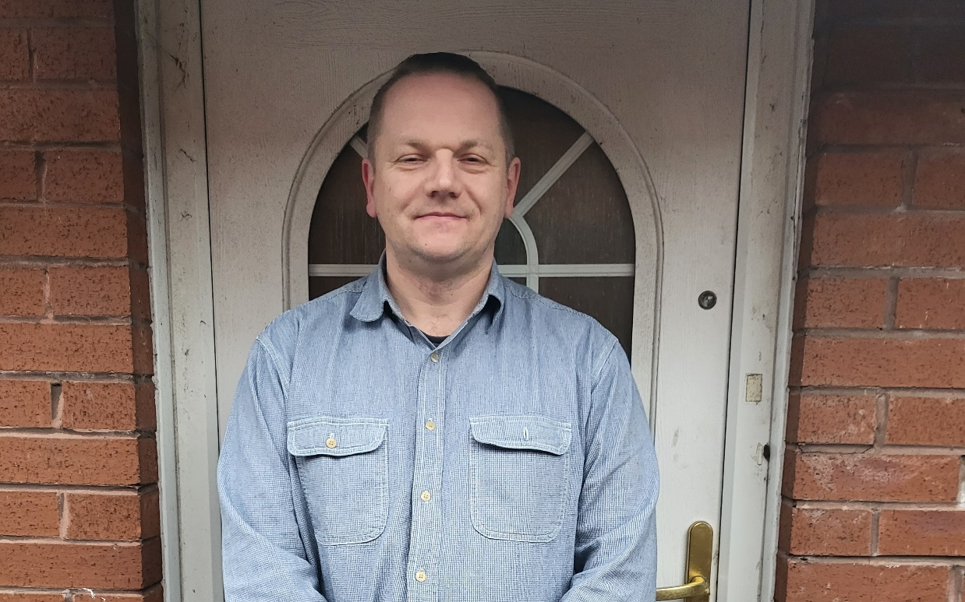
Link to full video:
https://www.veed.io/view/79434d92-c44e-432f-916f-3707153e12bf
Notes:
This is Peter. Peter, like most of us has good days and bad days so we agreed that we would record Peter's story in advance.
Now Peter has an amazing story to tell and is passionate about sharing it as he wants to inspire others and to be honest we could have filled a whole hour with Peter so we have pulled out some of Peter's key points.
Just in case anyone doesn’t know what a yellow van, in Peter’s mind it symbolizes being locked up in an asylum. Peter had an interesting school life with lots of stories that he can tell. It was when he got his job as a bin man that Peter began to feel fulfilled, he had a sense of achievement and purpose.
So when Peter comes to us at KeyRing that sense of self has been taken away. He now understands where the voices are coming from and he feels a sense of relief. This label has limited what society believes he can achieve and Peter himself believes he can achieve. And it’s my job to show Peter that he has value and still has plenty to offer.
Peter has used his own skills and ability with help and support to change his own story and to prove to the world that he does not have limitations.
Peter uses tools to manage and work through his issues and is empowered to add to the community.
As you can see there, Peter is very proud of what he has done, the way that he has turned his life around and continues to do so. Like Peter, we have lots and lots of Members who are overcoming massive difficulties and using their own strengths, power and skills with support to change their own future to change their own lives.

Slide 22

Thank you
Notes:
Karyn will be joined on the panel by Natalie Harris a Member of our KeyRing support in Lambeth.
Thanks for listening.

Slide 23
Jayne Wilson,
Emma Jenkins and Sam Temby
Shared Lives Plus
@SharedLivesPlus
@AssocMHP
#CommunityMH

Slide 24
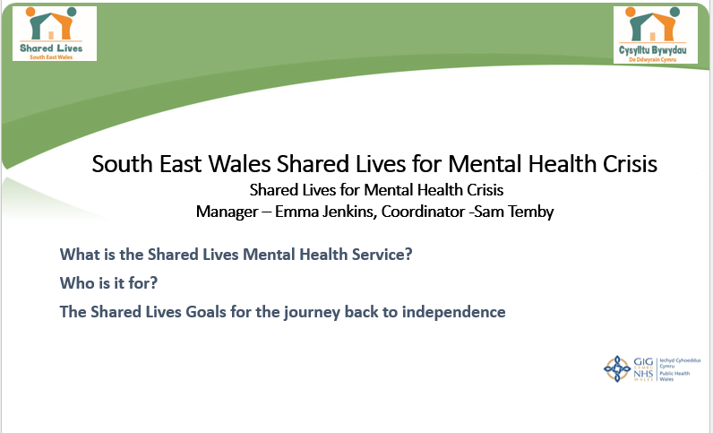
Notes:
For information please contact: Kathryn@sharedlivesplus.org.uk
What is Shared Lives?
A Shared Lives carer shares their home and family life with someone who needs support to live well and independently.
In the UK we have 141 Shared Lives schemes which support almost 12500 people via 9000 Shared Lives carers and most geographical areas are covered by our work.
The support the carers offer is flexible, tailored to the needs of the individual. It can be as little as a few hours a day, once or twice a week, overnight stays and respite for family carers - or it can be a long term relationship where the person moves in to the Shared Lives carers home. 66% are supported in long term arrangements and 67% of peoples’ primary support need is LD
The care they provide is monitored by Shared Lives schemes and the service is regulated and inspected by the care regulators. (CIW in Wales/ Care Quality Commission ). It is the highest rated form of social care with over 96% of schemes rated good or outstanding. But more importantly the outcomes for people are also high 98% people in Shared Lives felt they were part of the family most or all of the time.
87% people felt that their Shared Lives carer’s support improved their social life.
92% people in Shared Lives felt involved with their community.
It is personalised and allows people to live their best lives – all down to our fantastic carers. Our Shared Lives carers are recruited from the community, they undergo assessment, receive training and regular support. We have a wealth of experience in matching a Shared Lives carer with an individual and both people have voice, choice and control. The matching process is vitally important.
At Shared Lives Plus we think that Shared Lives could be an option for pretty much anyone who wants it. It is based on a relationship between two people, and both talk about the benefits they get from being involved. We have been involved in supporting schemes to diversify the model – and we recognise that supporting people around mental health is vital. Now 7% of the people drawing upon the support is for poor mental health and that grows by about 13% each year.
One of the schemes which has led the way in this work is South East Wales and I will pass you on to Emma to tell you more about the work here.
Background about our scheme: largest scheme in Wales, 28 staff, 240+ carers, accommodating 550 services, our ethos and values aligned with Whole Person and Whole System hence it was a natural fit when they approached us….
What is the Shared Lives Mental Health Service?
Bit of background first:
We began our journey by applying for WGovt funding and were successful in our bid for 2yrs of funding for our new Shared Lives Mental Health Crisis Project.
In April 2019 we entered into a Service Level Agreement with the Aneurin Bevan University Health Board to provide Shared Lives arrangements for people experiencing Mental Health crisis and by August the initial Pilot Project started with the Newport Crisis Team
2020 saw the project expanded to include the other Crisis teams across the whole Gwent area/Health Board.
Last year the Health Board became an official partner, enabling further roll out of the service.
The service itself…
The service provides an alternative to, or facilitates early discharge from, an inpatient hospital setting based in the community within an approved Shared Lives Carer’s own home.
Based on evidence that individuals experiencing a mental health crisis recover better if they feel part of the community, are in a supportive family setting, and are able to take part in a daily routine.
Shared Lives provides up to 4 weeks of support for each patient, depending on assessed need, with the average length of stay being 14 nights.
Who is it for?
We support people who have had an inpatient stay on a MH Ward and are recovering from a mental health crisis, they are discharged to the Shared Lives carers home. (Period of up to 4 wks)
Or we are able to provide an alternative to in-patient psychiatric admission. The person is able to move in with the Shared Lives carer short term rather than going in to hospital. Aim is to prevent escalation of their crisis and support their recovery.
Could be anyone from any walk of life…(a mature student/a lady who had experienced sexual trauma found it was an inappropriate environment for her on the ward where there were mainly male patents therefore Shared Lives was more appropriate)
The Shared Lives Goals for the journey back to independence?
We focus on:
preparing healthy food and shopping (With Shared Lives - trusted to use kitchen appliances and utensils a knife)
Structure to the day/week
budgeting
household tasks (With Shared Lives – sense of purpose, feeling valued by contributing to cleaning, maintaining a home)
expanding the individual’s social circle and community links (With Shared Lives – trusted with mobile phone charging lead = keeping in touch via mobile with friends)
gaining confidence and increasing independence
accessing work or education (Within Shared Lives - Nikita but change the name, managing to continue with her studies once off the Ward)
- attending and maintaining medical care
- Maintaining own wellbeing (With Shared Lives - pets, own bed, peace and quiet, freedom to walk/physical exercise/cups of tea/peace and quiet/own bed

Slide 25
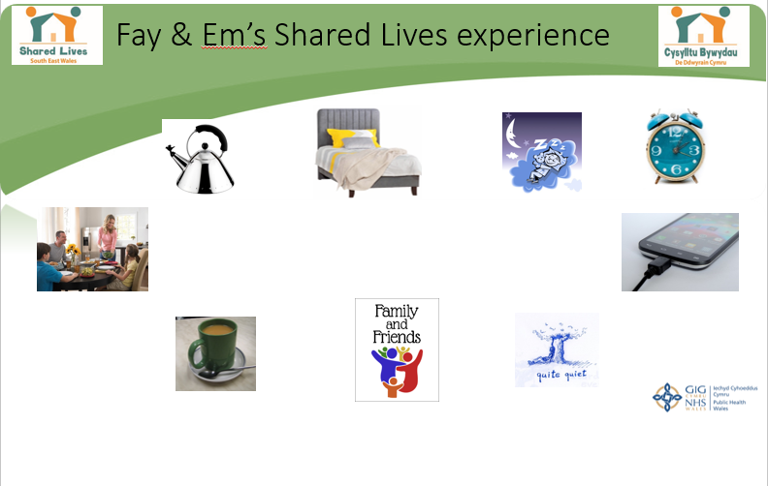
Notes:
I would like to share a audio clip that was recorded last Autumn, it features myself the Shared Lives Coordinator, Fay the Shared Lives Carer and a young lady Em who received a 4 week arrangement to support hospital discharge. Friends alerted emergency services following a bout of Depression and fears of Em trying to take her own life when they could not make contact with her, sadly their instincts were right but help was sought just in time. Em was admitted onto Ty Cyfannol Mental Health Ward and found the experience difficult – just as many do whilst trying to recover. Em is going to talk though the differences she found from being in a ward environment compared to Shared Lives, and what this step down from ward meant to her to be able to confidently return to her own home. Em is an incredibly intelligent lady who moved to the area for a degree and masters in the Pharmaceutical sector, and choose to remain after securing a job and making friends. She is a nervous person but very brave in sharing her story with the hope to help others. Em chose to have her voice recorded and this was filmed using a basic handheld mobile phone device so please bare with us on the technical sides of things and turn the volume up on your devices to ensure you hear her moving words.
Following recoding this, Em is happy for me to share that she has continued to recover, and feels strongly that now she knows Fay is there to have chat on the phone or cup of tea with on her down days, that’s enough to prevent admission again in her eyes – just knowing someone is there.
We’re very grateful to Em for sharing her story. She hopes to help others.
Following this recording, Em has continued to recover, she knows Fay is there for a chat or cup of tea on her down days, that’s enough to prevent another admission in her eyes – just knowing someone’s there.

Slide 26
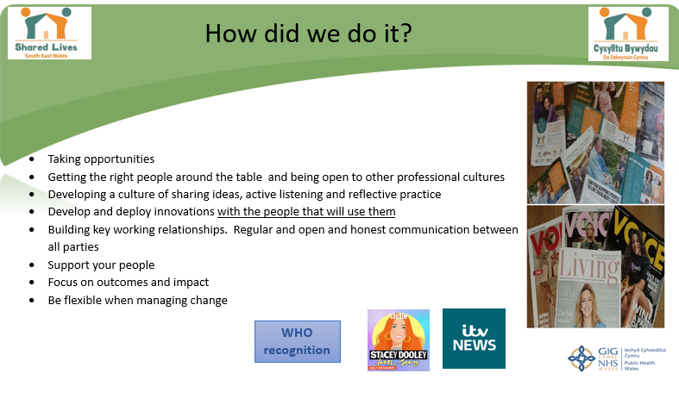
Notes:
Where are we now?
Outcomes:
To date 120 patients have been supported
Total 1708 nights of tailored support
Of the Total referrals (progressed): 46 of referrals direct from home, 74 were from hospital.
Small number of referral that do not progress (12 of 132 referrals)– all cases considered individual with no criteria for referral. (Of those 12 it tends to be the individual’s choice that prevents the arrangement going ahead).
The Shared Lives Mental Health Service is now fully funded by Health and mainstream
Dec 2021 – From a Health Board perspective: Winter Bed Management pressures alleviated by Shared Lives working with Home Treatment Team over the Christmas period.
MH Crisis service Shared Lives carer nominated for Wales Carer Award
In June 2021 – Our service was showcased by the World Health Organisation in their ‘Guidance on Community Mental Health Services’ as one of only 3 services from the UK and 26 in total world-wide to be recognised. The Guidance included information of a transformational service promoting a person-centred and human rights based approach in mental health.
The Future - Currently we work with the ‘adults mental health division’ we’d be looking to set up a similar service for older adults 65+. We would also like to support younger adults 16+ CAM’s, we have ongoing discussions – there is so much scope for this service, what this space!

Slide 27
Sara Gray and
Tracey Stinchcombe
Missing Link
@MissingLink_MLH
@AssocMHP
#CommunityMH

Slide 28
Discussion
Please use the Q&A tab or the chat box to submit your questions.
@AssocMHP
#CommunityMH

Slide 29
Thank you!
Get in touch: info@amhp.org.uk
Find out more: www.amhp.org.uk
@AssocMHP
#CommunityMH

